Slide 1
Text Processing
%d parseInt
‘6’ -> 36h -> 0011 0110 -> 0000 0110
‘2’ -> 32h -> 0011 0010 -> 0000 0010
+ 0110 1000 0000 1000
‘8’ -> 38h -> 0011 1000

Slide 2
Objectives: Learning Outcomes
2
LO8.1 Describe the Text Processing problem and its’ application.
LO8.2 Explain the Brute Force Text Pattern-Matching algorithm.
LO8.3 Describe the main idea of The Knuth-Morris-Pratt Algorithm.
LO8.4 Explain The Huffman Coding Algorithm.
LO8.5 Explain steps needed to use The Huffman Coding Algorithm for compressing a text file.
LO8.6 Explain the LZW encoding algorithm.
LO8.7 Explain the Run-length encoding algorithm.
Notes:
2

Slide 3
Contents
3
1- Abundance of Digitized Text
2- String Matching
Brute-Force algorithm
Knuth-Morris-Pratt Algorithm
3- Data Compression
Condition for Data Compression
Huffman Coding Algorithm
LZW Algorithm
Run-length Encoding
Your work: Re-implement demonstrations in this lecture.
Notes:
3

Slide 4
1- Abundance of Digitized Text
Despite the wealth of multimedia information, text is still main data format in computers
Text is digitalized (ASCII, EBCDIC,… or a pre-defined code table)
WWW → HTML, XML, text documents, email,…
Many data sets are stored in text format (String)
Two basic problems on text data:
Matching a substring (search operation)
Compressing a document

Slide 5
2- String Matching
Given a string S, the problem of string matching deals with finding whether a pattern p occurs in S and if p does occur then returning position in S where p occurs.
S= “ssdf egeg h5yh r5h45h j 6rhr”
P=“h5y”
➔ position = 10
2 algorithms are introduced:
The Bruth Force Algorithm
The Knuth-Morris-Pratt (KMP) Algorithm

Slide 6
2- String Matching…
The Bruth-Force Algorithm
Brute Force approach: A way for proving/programming in which a problem will be evaluated in all cases – vét cạn, exhausted searching.
S ( length n=10)
D | B | C | D | E | F | A | T | H | E
D | E | F | E
 | D | E | F | E
 |  | D | E | F | E
 |  |  | D | E | F | E
 |  |  |  | D | E | F | E
 |  |  |  |  | D | E | F | E
 |  |  |  |  |  | D | E | F | E
p (length m=4)
Loop (n-m+1) times
Loop matching 4 pair of characters
O((n-m+1)(m)) ➔ O(nm)
Drawback: SLOW

Slide 7

2- String Matching…
The Bruth Force Algorithm
Project for demonstration

Slide 8
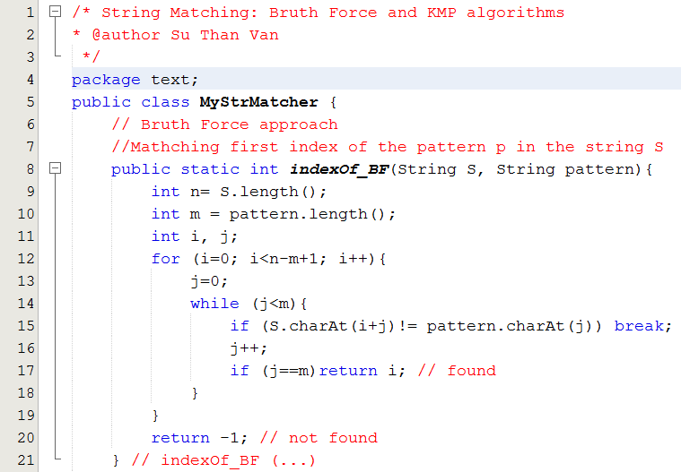
2- String Matching…
The Bruth Force Algorithm

Slide 9
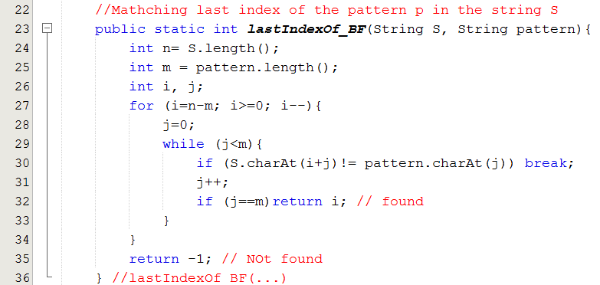
2- String Matching…
The Bruth Force Algorithm

Slide 10
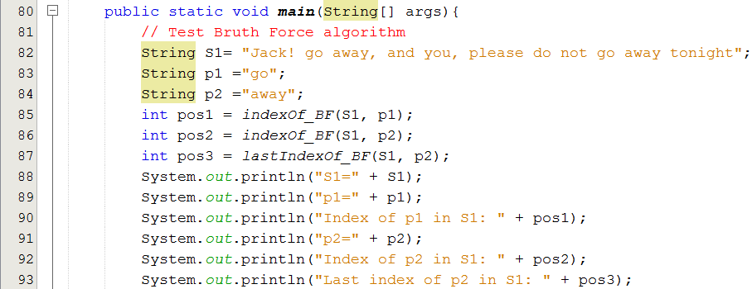
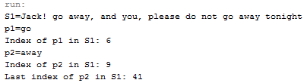
2- String Matching…
The Bruth Force Algorithm

Slide 11
2- String Matching…
The Knuth-Morris Pratt Algorithm
Knuth, Morris and Pratt proposed a linear time algorithm for the string matching problem.
A matching time of O(n+m) is achieved by avoiding comparisons with elements of S that have previously been involved in comparison with some element of the pattern p to be matched. i.e., backtracking on the string S never occurs.
Main idea: Pattern may be shifted MORE THAN ONE position in the source string.

Slide 12
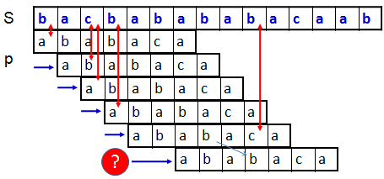
2- String Matching…
The Knuth-Morris Pratt Algorithm

Slide 13
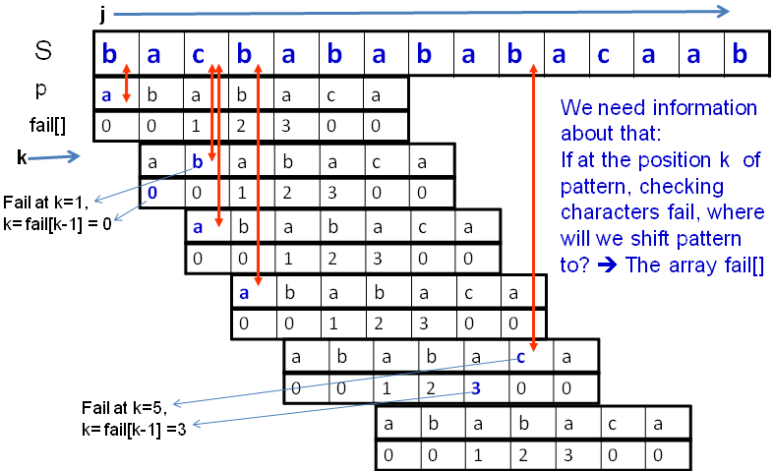
2- String Matching…
The Knuth-Morris Pratt Algorithm

Slide 14
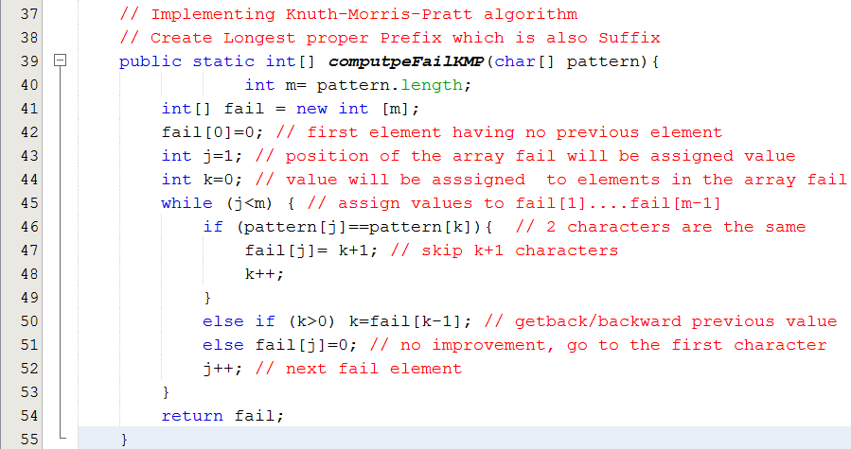
2- String Matching…
The Knuth-Morris Pratt Algorithm

Slide 15
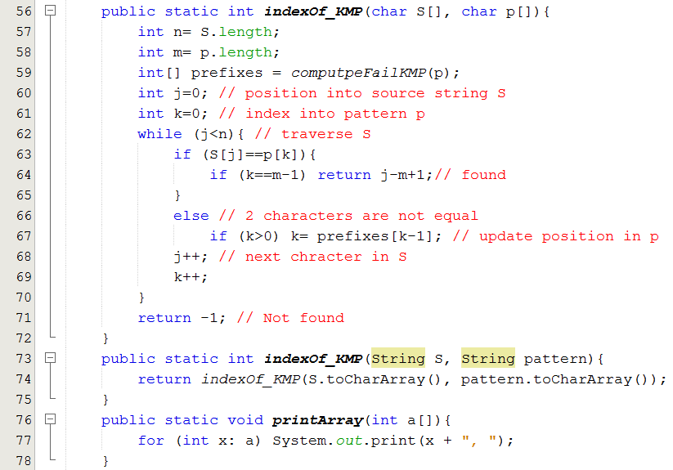
2- String Matching…
The Knuth-Morris Pratt Algorithm

Slide 16
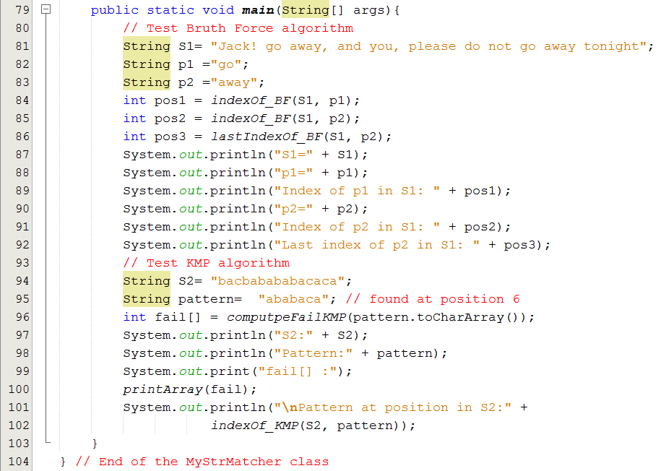

2- String Matching…
The Knuth-Morris Pratt Algorithm

Slide 17
3- Data Compression
Introduction to data compression
Some Compression Algorithms:
Huffman Encoding
Lempel-Ziv
RLE: Run Length Encoding

Slide 18
3- Data Compression…
Introduction
encoding
Raw data (10KB)
Compressed data (2KB)
decoding
Data compression or source coding is the process of encoding information using fewer bits (or other information-bearing units) than an un-encoded representation would use through use of specific encoding schemes.” (Wikipedia)
Advantage: It reduces the consumption of storage (disks) or bandwidth (băng thông, tốc độ truyền- bits/sec).
Disadvantage: it needs processing time to restore or view the compressed code.

Slide 19
3- Data Compression…
Introduction
Classification:
Lossy: MP3 ← → WAV, JPG ←→ BMP
Lossless: ZIP, GZ
Compression Algorithms:
Huffman Encoding
Lempel-Ziv
RLE: Run Length Encoding
→ Performance of a compression method depends on file type.

Slide 20
3- Data Compression…
Introduction
Basic of Lossless compression:
Use smaller number of bits to store a data unit (8 bit-character- symbol).
Codeword: sequence of bits corresponding to a symbol. Codeword of a symbol is unique.
Average codeword length indicates efficiency of a compression .
Compression rate
length(input) – length (output) → dL
length(input) → L
Compression rate is used to compare the efficiency of different data compression methods when applied to the same data.

Slide 21
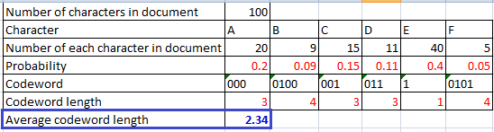
3- Data Compression…
Introduction
Basic of Lossless compression:
How to compute average of average codeword length? → Use the entropy formula – trung bình mức độ lộn xộn
L_{ave} = H = P(x₁)L(x₁) + · · · + P(x_{n})L(x_{n})
In which:
P(X_{i}): probability of the symbol X_{i}.
L(X_{i}): Codeword length of the symbol X_{i}.
Sum of products

Slide 22
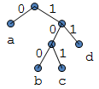
3- Data Compression…
Introduction
Basic of Lossless compression:
Properties of a set of codewords:
A variable length code assigns a bit string
(codeword) of variable length to every message value
a = 0, b = 100, c = 101, d = 11
A uniquely decodable code is a variable length code in which bit strings can always be uniquely decomposed into its codewords.
A prefix code is a variable length code in which no codeword is a prefix of another codeword. It can be viewed as a binary tree with message values at the leaves and 0 or 1s on the edges.

Slide 23
3- Data Compression…
Introduction
A
D
Prefix code: Exercises
Given codeword sets. What set are invalid? And why they are not?
a = 0, b = 100, c = 101, d = 11
A: 000, B: 0100, C: 001, D: 011, E: 1, F: 0101
A: 00, B: 010, C: 001, D: 011, E: 1, F: 0101
A: 001, B: 010, C: 001, D: 011, E: 1, F: 0101
A: 01, B: 001, C: 011, D: 011, E: 10, F: 0101

Slide 24
3- Data Compression…
Introduction
Prefix code: Exercises
Given codeword set:
a = 0, b = 100, c = 101, d = 11
(1) String “bacadaba” will be encoded to ___
(2) String “cadcaadacba” will be encoded to ____
(3) Encoded string “100,11,0,11100100” will be decoded to _____
(4) Encoded string “10111000100101” will be decoded to _______

Slide 25
3- Data Compression…
Introduction
For a code C with associated probabilities p(c) the average length is defined as
We say that a prefix code C is optimal if for all prefix codes C, l_{a}(C) ≤ l’_{a}(C), l’_{a}(C) is average codeword length of other code set.
The Huffman code is known to be probably optimal under certain well-defined conditions for data compression.

Slide 26
3- Data Compression: Huffman Alg.
Main idea: Encode higher probability symbols with fewer bits
Huffman Coding Algorithm
Example: Character (or symbol) frequencies
A : 20% (.20)
B : 9% (.09)
C : 15% (.15)
D : 11% (.11)
E : 40% (.40)
F : 5% (.05)
(Step 1) Doing preparation: Determine frequency of each character then compute probability of each character.
Prob. = char. count/ number of chars. in document
You have to complete the Huffmann tutorial.

Slide 27
3- Data Compression: Huffman Alg…
Huffman Coding Algorithm
(Step 2) Constructing Codeword tree
Symbols and their associated frequencies in descending order based on probabilities.
Now we combine the two least common symbols (those with the smallest frequencies) to make a new symbol string and corresponding frequency.
0.14
E
.40
A
.20
C
.15
D
.11
B
.09
F
.05
Notes:
27

Slide 28
3- Data Compression: Huffman Alg…
Huffman Coding Algorithm
Here’s the result of combining symbols once.
Now repeat until youve combined all the symbols into a single string.
E
.40
A
.20
C
.15
BF
.14
D
.11
B
.09
F
.05
<
<=
Notes:
28

Slide 29
3- Data Compression: Huffman Alg…
Huffman Coding Algorithm
Here’s the result of combining symbols once.
Now repeat until youve combined all the symbols into a single string.
E
.40
BFD
.25
A
.20
C
.15
BF
.14
D
.11
B
.09
F
.05

Slide 30
3- Data Compression: Huffman Alg…
Huffman Coding Algorithm
Here’s the result of combining symbols once.
Now repeat until youve combined all the symbols into a single string.
E
.40
AC
.35
BFD
.25
A
.20
C
.15
BF
.14
D
.11
B
.09
F
.05
Notes:
30

Slide 31
3- Data Compression: Huffman Alg…
Huffman Coding Algorithm
BFDAC
.60
E
.40
AC
.35
BFD
.25
A
.20
C
.15
BF
.14
D
.11
B
.09
F
.05
Notes:
31

Slide 32
3- Data Compression: Huffman Alg…
Huffman Coding Algorithm
BFDACE
1.00
0
1
BFDAC
.60
E
.40
(Step 3) Generating Prefix Codewords:
A: 000
B: 0100
C: 001
D: 011
E: 1
F: 0101
0
1
AC
.35
BFD
.25
0
1
0
1
A
.20
C
.15
BF
.14
D
.11
0
1
B
.09
F
.05
Notes:
32

Slide 33
3- Data Compression: Huffman Alg…
Huffman Coding Algorithm
33
Make a leaf node for each code symbol
Add the generation probability or the frequency of each symbol to the leaf node (arrange them from left to right in descending order by probability)
Take the two leaf nodes with the smallest probability and connect them into a new node
Add 1 or 0 to each of the two branches
The probability of the new node is the sum of the probabilities of the two connecting nodes
If there is only one node left, the code construction is completed. If not, go back to (2)

Slide 34
3- Data Compression: Huffman Alg…
Average code length:
Character | Code | Length | Probability
A | 000 | 3 | .20
B | 0100 | 4 | .09
C | 001 | 3 | .15
D | 011 | 3 | .11
E | 1 | 1 | .40
F | 0101 | 4 | .05
Average Code Length:
(3 x 0.20) + (4 x 0.09) + (3 x 0.15) + (3 x 0.11) + (1 x 0.40) + (4 x 0.05)
= 2.34 digits
Notes:
34

Slide 35
3- Data Compression…
Huffman Coding Algorithm
Notes:
There is no unique Huffman code
Assigning 0 and 1 to the branches is arbitrary
If there are more nodes with the same probability, it doesn’t matter how they are connected. However, if the probability in each node is unique and the left nodes probability is always larger than the rights one, then the code is unique.
When some sub-trees having the same probabilities, the position will add a sub-tree will affect to result.
Notes:
35

Slide 36
3- Data Compression… Lempel-Ziv Compression
36
Originated by Abraham Lempel and Jacob Ziv, improved by Tery Welch in 1984 (that is why it gets name LZW)
Encode sequences of symbols with location of sequence in a dictionary => dictionary coder
This coding method is lossless coding
Files are commonly used: GIF, TIFF
Algorithms versions: LZ77, LZ78 and LZW

Slide 37

3- Data Compression/Decompression: LZW Alg.
37
Compressing
Zipping Dictionary:
<subString, intCode>
// First 256 entries for ASCII codes
List of integral codes
Characters
Add newStr
Data source
subStr
int code
Zipped result
Add newStr
Unzipping Dictionary:
<intCode, subString>
// First 256 entries for ASCII codes
Read data-source and write result only one time → Fast
To decrease file size, codes are divided into some groups using different code-lengths
De-compressing

Slide 38
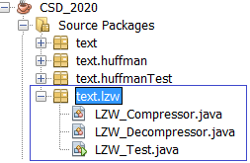
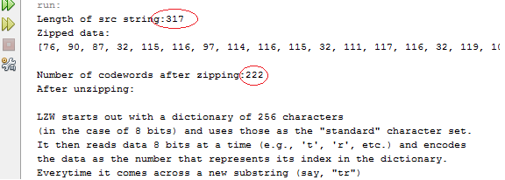
LZW Encoding Algorithm: Demo
38
String → Array of integral codes
Notes:
GIF file
38

Slide 39
3- LZW Encoding: Characteristics
LZW uses a dynamic dictionary, each dictionary entry is a pair of <inputSubString, code>. If a substring from input existed in dictionary, this input substring will be replaced by corresponding code (code in bit string format, called as token) → Reading a substring in input and writing its token to output can be performed concurrently → FAST. If inputSubString is not in dictionary. It is put to dictionary with a new code.
Dictionary is not written to output because when zipped data is unzipped. New dictionary will be constructed for decoding in the reverse way.
Dictionary structure
- First 256 entries are reserved for basic 256 characters:
<ASCII character, code>, code: 0.255.
- Followings are entries for substring of 2 characters, then 3 characters, and so on → LZW code length > 8.
Notes:
GIF file
39

Slide 40
3- Data Compression… LZW Encoding Algorithm
LZW Principles:
An input string contains at least 2 characters.
If an input string was recorded in dictionary, it is replaced by corresponding token (LZW bits), else it will be add to dictionary with a new entry (token, inputString)
Compression will gain better result when dictionary containing entries with input length greater than 2.
Notes:
GIF file
40

Slide 41
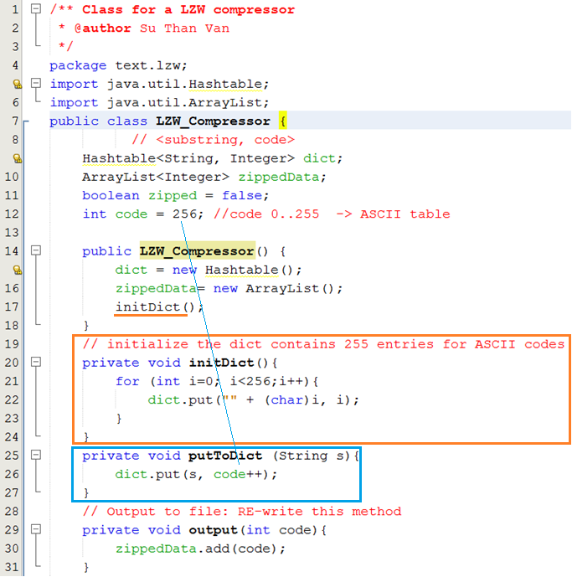
LZW Encoding Algorithm: Demo
41
// tự điển mã hoá
// mảng kết quả mã hoá
// mã hoá xong chưa?
// mã cho chuỗi con >=2 ký tự sẽ đi từ 256
Thêm 1 chuỗi con vào dict với mã tự động tăng 1
Thêm 1 mã vào kết quả mã hoá
Notes:
GIF file
41

Slide 42
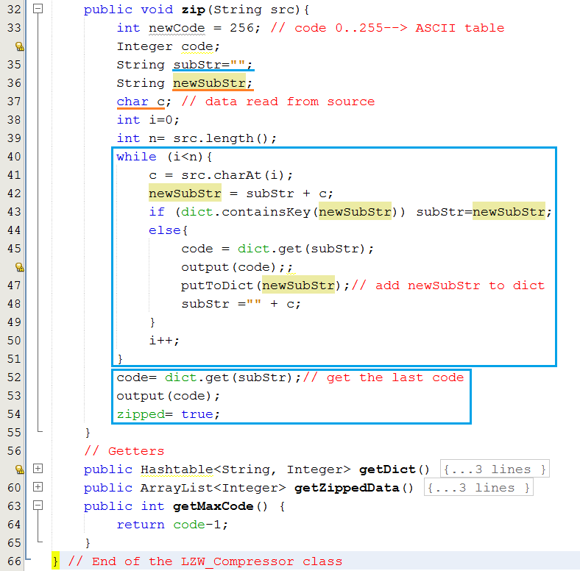
LZW Encoding Algorithm: Demo
// chuỗi con đang được xem xét
// chuỗi con mới được phát hiện
42
// chuỗi mới = chuỗi cũ nối thêm ký tự vừa đọc (c) vào cuối.
Nếu chuỗi mới chưa có trong dict:
Mã hoá chuỗi cũ
Đưa chuỗi mới vào dict
Bắt đầu đi khám phá chuỗi mới bắt đầu từ ký tự c
Notes:
GIF file
42

Slide 43
3- LZW Decoding: Characteristics
LZW uses dynamic dictionary, each dictionary entry is a pair of <code, inputSubString>. If a code from input existed in dictionary, the corresponding substring will be written to output → Reading a zipped code and writing its substring to output can be performed concurrently → FAST. If a code is not in dictionary, the pair <code, newSubString> will be put to dictionary .
Dictionary structure
- First 256 entry in dictionary are <code, ASCII character>, code 0..255.
- Followings are entries for substring of 2 characters, then 3 characters, and so on.
Notes:
GIF file
43

Slide 44
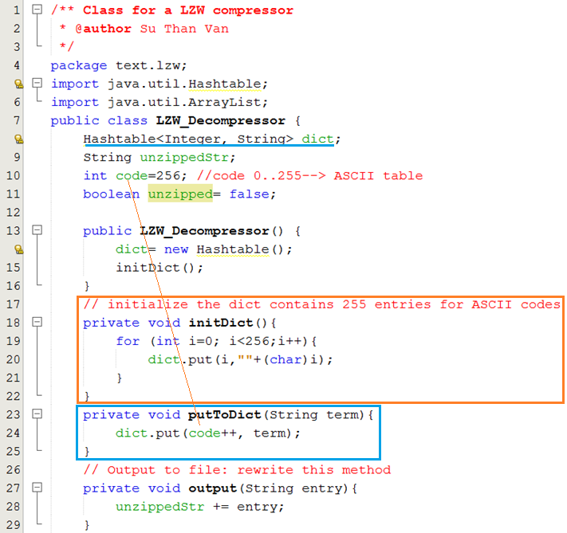
LZW Encoding Algorithm: Demo
44
// Từ điểm giải mã
// Chuỗi kết quả giải mã
// Chuỗi 2 ký tự có mã > 255
// Đã giải mã xong chưa?
Khởi tạo dict cho 256 ký tự của bảng mã ASCII
Thêm vào dict một chuỗi con
Thêm 1 chuỗi con vào kết quả giải nén
Notes:
GIF file
44

Slide 45
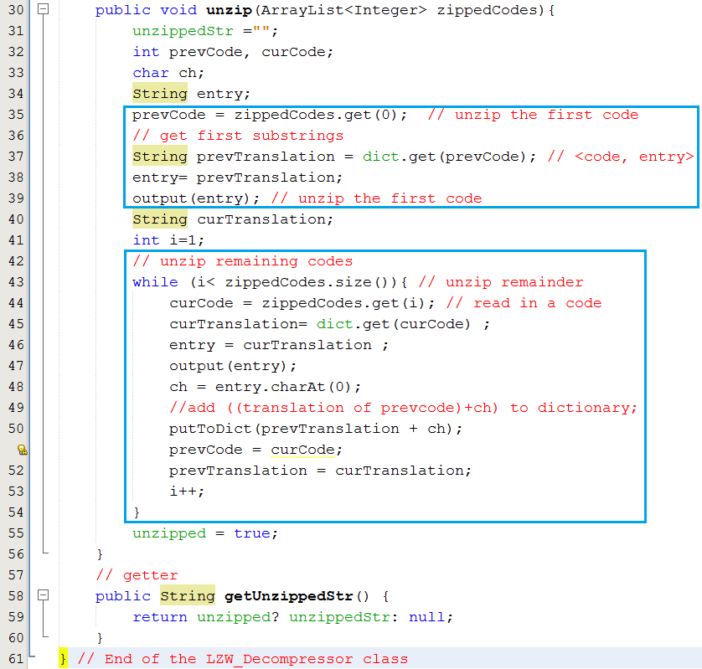
Input= mảng các mã
LZW Encoding Algorithm: Demo
45
Giải nén mã đầu tiên, vị trí 0 → ASCII character
// Chuỗi con đã giải nén hiện hành
// Đi từ mã ở vị trí 1
Giải nén mã thứ i → entry (chuỗi con) đưa vào kết quả giải mã hiện hành
Chuỗi con mới = chuỗi con cũ nối thêm ký tự đàu của entry → Đưa chuỗi con mới vào từ điển.
Lặp lại giải nén mã kế tiếp
Notes:
GIF file
45

Slide 46
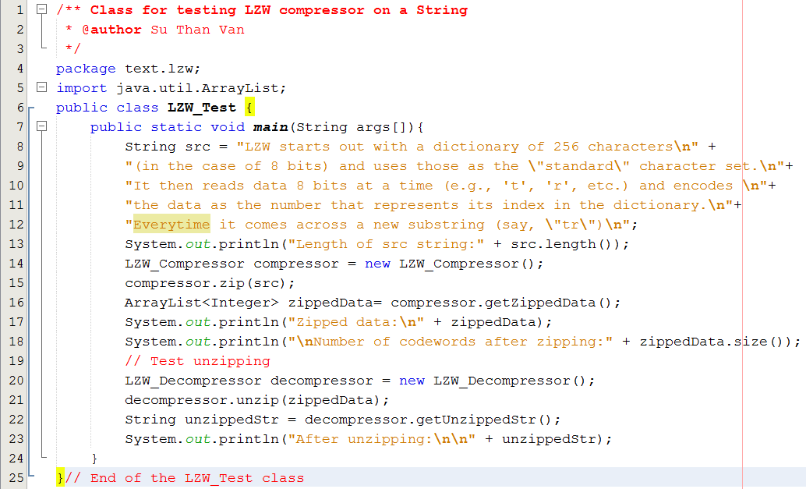
LZW Encoding Algorithm: Demo
46
Notes:
GIF file
46

Slide 47
3- Data Compression… Run-Length Encoding
Numeric run: Group of non-decreasing contiguous numbers.
1 2 8 5 5 6 7 9 8 3 4 6 → 4 runs
Character run: Group of the same contiguous characters.
AAABCDDDE : 5 runs

Slide 48
3- Data Compression… Run-Length Encoding
FFFFOOOOFFFOOFFFFFOOOOOOOO
Raw :
4
4
3
2
5
7
Compressed:
4F4O3F2O5F7O
Compression Rate = (25-12)/25 = 52%

Slide 49
Summary
Digitalized text: Text in which each it’s character is coded as a bit string.
Abundance of Digitized Text: Text is still main data in computer programs
Brute-Force algorithm helps searching a short string in a long string using exhaustive approach and it’s complexity O(mxn). m is the length of long string and m is the length of short string.
Knuth-Morris-Pratt Algorithm helps matching a short string in a long string using improvement in shift steps and it has complexity of O(n+m).

Slide 50
Summary
Data Compression is a process to shorten initial data in order to reduce storage or bandwidth of communication.
Condition for Data Compression is codeword table of initial data unit.
Huffman Coding Algorithm is a lossless compression technique in which each initial source character will be expressed using number of bits less than 8. Codewords are generated based on character’s frequencies.
LZW Algorithm is a lossless compression technique based on a dictionary of input string.
Run-length Encoding is a lossless compression technique based on run of characters in input string.

Slide 51
Objectives: Learning Outcomes

LO8.1 Describe the Text Processing problems and its’ application.
LO8.2 Explain the Brute Force Text Pattern-Matching algorithm.
LO8.3 Describe the main idea of The Knuth-Morris-Pratt Algorithm.
LO8.4 Explain The Huffman Coding Algorithm.
LO8.5 Explain steps needed to use The Huffman Coding Algorithm for compressing a text file.
LO8.6 Explain the LZW encoding algorithm.
LO8.7 Explain the Run-length encoding algorithm.






Notes:
51

